Slide 1
Work and Energy

Slide 2
Chapter Contents
Work
Work and Energy
Conservation of Energy
Power

Slide 3
Work
While most people feel that work is done when you "work on a problem" or "do homework," physicists say work has only been done when a force is applied to an object and the object moves in the direction of the applied force.

Slide 4
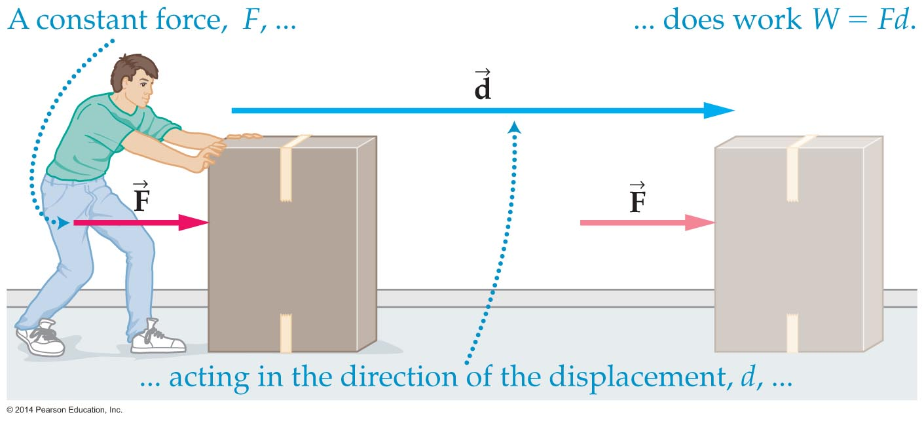
Work
Work being done as a force pushes a box through a displacement. The work done equals W = Fd.
Units -- The product of F and d, N·m, is called the Joule (J)

Slide 5
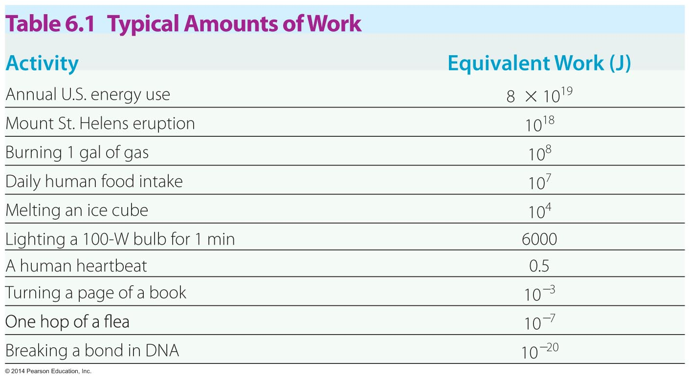
Work
A joule is a small unit. You do a joule of work when you lift a medium-sized apple through a height of 1 meter.
The table below provides some examples of typical amounts of work.

Slide 6
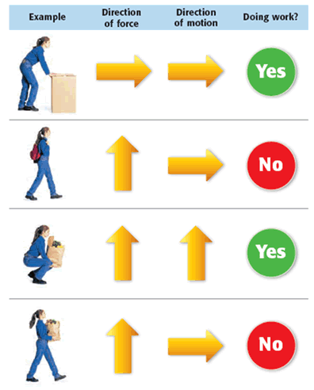
Work
It may come as a surprise that no work is done while holding a heavy object such as a suitcase.
By the definition of work, because the suitcase doesn't move, no work is done. However, you become tired because your muscle cells are doing work holding the suitcase.

Slide 7
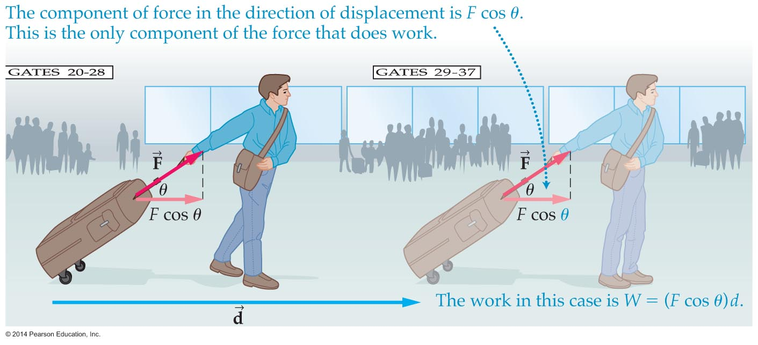
Work
Work is easily calculated when the force and displacement are in the same direction, but how is work calculated when the force is at an angle to the displacement?
The figure below shows a person pulling a suitcase at an angle θ with respect to the direction of motion.

Slide 8
Work
In a case such as this, only the component of the force in the direction of the displacement does work.
Notice in the previous figure that the component of force in the direction of displacement is F cosθ. Therefore, the work equals Fd cosθ.

Slide 9
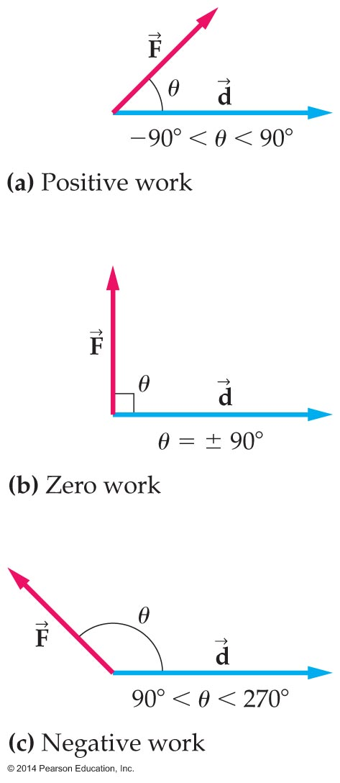
Work
Work can be positive, negative, or zero.
Work is positive if the force has a component in the direction of motion (Figure a).
Work is zero if the force has no component in the direction of motion (Figure b).
Work is negative if the force has a component opposite the direction of motion (Figure c).

Slide 10
Work
When more than one force acts on an object, the total work is the sum of the work done by each force separately.
For example, if does work W₁, force does work W₂, force does work W₃, and so on, the total work equals
W_{total} = W₁ + W₂ + W₃ + …

Slide 11
Work and Energy
When work is done on an object, the object's energy changes. For example:
When you push a shopping cart, your work goes into increasing the cart's kinetic energy.
When you climb a mountain, your work goes into increasing your potential energy.
Thus kinetic energy is energy of motion; potential energy is the energy of position or condition.

Slide 12
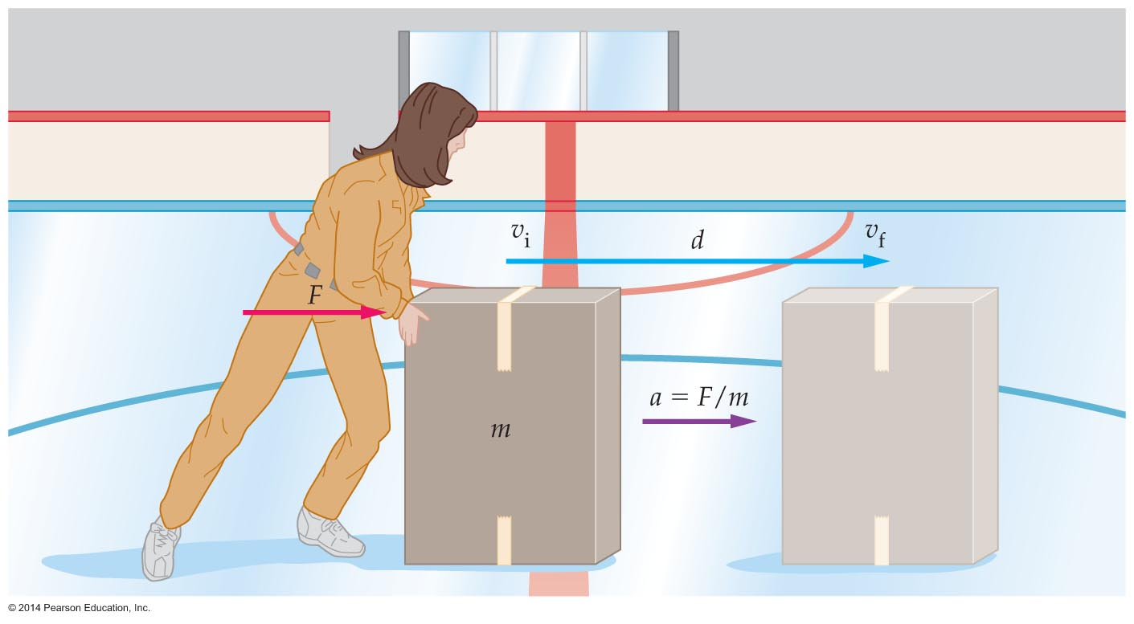
Work and Energy
Newton's laws and the equations of motion may be used to derive a relationship between work and energy.
In the figure below, a box is pushed across an ice-skating rink with a force F. Let's see how this force changes the box's energy.

Slide 13
Work and Energy

Slide 14
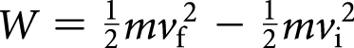
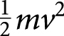
Work and Energy
From the relationship , we see that the work done on the box (or on any other object) is related to the quantity .
The quantity is defined as the kinetic energy, or KE, of an object of mass m and speed v.

Slide 15
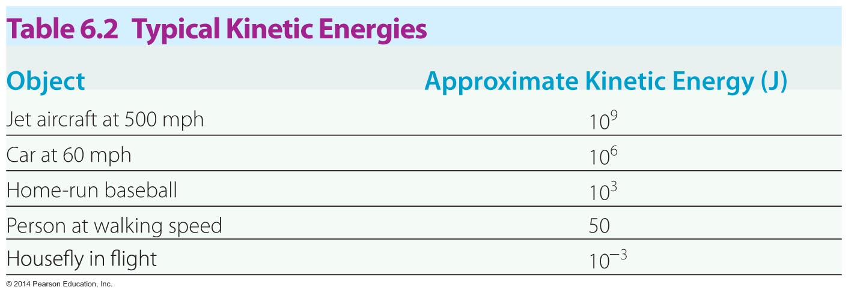
Work and Energy
In general, the kinetic energy of an object is the energy due to its motion.
Kinetic energy is measured with the joule, the same unit used to measure work.
The following table provides some examples of typical kinetic energies.

Slide 16
Work and Energy
The kinetic energy increases linearly with the mass and with the square of the velocity, as the following example indicates.

Slide 17
Work and Energy
As the equation indicates, the total work done on an object equals the change in its kinetic energy. This connection is known as the work-energy theorem:

Slide 18
Work and Energy
The following example shows how work is related to the change in kinetic energy.

Slide 19
Work and Energy
The sign of the work is related to the change in kinetic energy:
If the total work is positive, then the kinetic energy increases.
If the total work is negative, then the kinetic energy decreases.
If the total work is zero, then there is no change in kinetic energy.

Slide 20
Work and Energy
The following example illustrates how the work-energy theorem may be applied when an object has an initial speed.

Slide 21
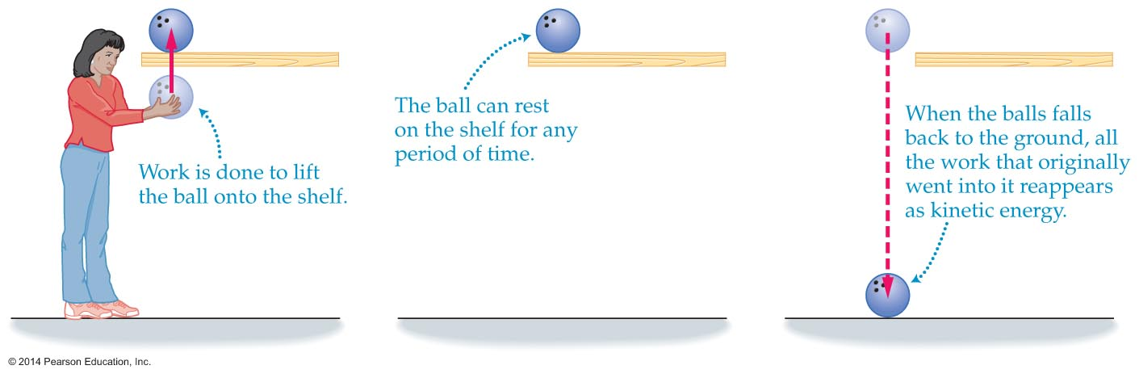
Work and Energy
As the figure below indicates, work must be done to lift a bowling ball from the floor onto a shelf.
Even though the ball has no kinetic energy once it's resting on the shelf, the work done in lifting the ball is not lost—it is stored as potential energy.

Slide 22
Work and Energy
Energy that is stored for later use is referred to as potential energy, or PE.
Potential energy has several forms, one of which is gravitational potential energy.
The gravitational potential energy equals the work required to lift an object to a given height.
Lifting a mass m from the ground to a height h requires a force mg. Thus the work done, and the potential energy acquired, equals force times distance, or
W = mgh

Slide 23
Work and Energy
The following example shows how the gravitational energy is calculated.

Slide 24
Work and Energy
Objects like rubber bands and springs that return to their original size and shape after being distorted are said to be elastic.
Stretching a spring requires work. This work is stored in the stretched spring in the form of potential energy.
The potential energy stored in a distorted elastic material is referred to as elastic potential energy.

Slide 25
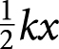
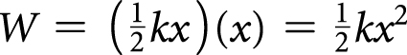
Work and Energy
When a spring is stretched by a distance x, the force exerted on the spring increases uniformly from 0 to kx, where k is the spring constant.
Thus, the average force is exerted on the spring is .
Since the average force is , the work done in changing the length of the spring is the average force times the distance, or
This work is stored as elastic potential energy.

Slide 26
Work and Energy
The following example shows how elastic potential energy is calculated.

Slide 27
Conservation of Energy
Energy takes many forms: mechanical, electrical, thermal, and nuclear.
Any time work is done, energy is transformed from one form to another.
One process might transform some kinetic energy into electrical potential energy; another might transform some spring potential energy into kinetic energy.
However, no matter what the process, the total amount of energy in the universe remains the same. This is what is meant by the conservation of energy.
To say that energy is conserved means that energy can never be created or destroyed—it can only be transformed from one form to another.

Slide 28
Conservation of Energy
When frictional forces act on a system, such as when a car's brakes are applied, kinetic energy is transformed into thermal energy.
In situations where all forms of friction can be ignored, no potential or kinetic energy is transformed into thermal energy. In this ideal case, the sum of the kinetic and potential energies is always the same.
The sum of the kinetic and potential energies of an object is referred to as its mechanical energy. Thus, mechanical energy = potential energy + kinetic energy
E = PE + KE
This means that mechanical energy is conserved.

Slide 29
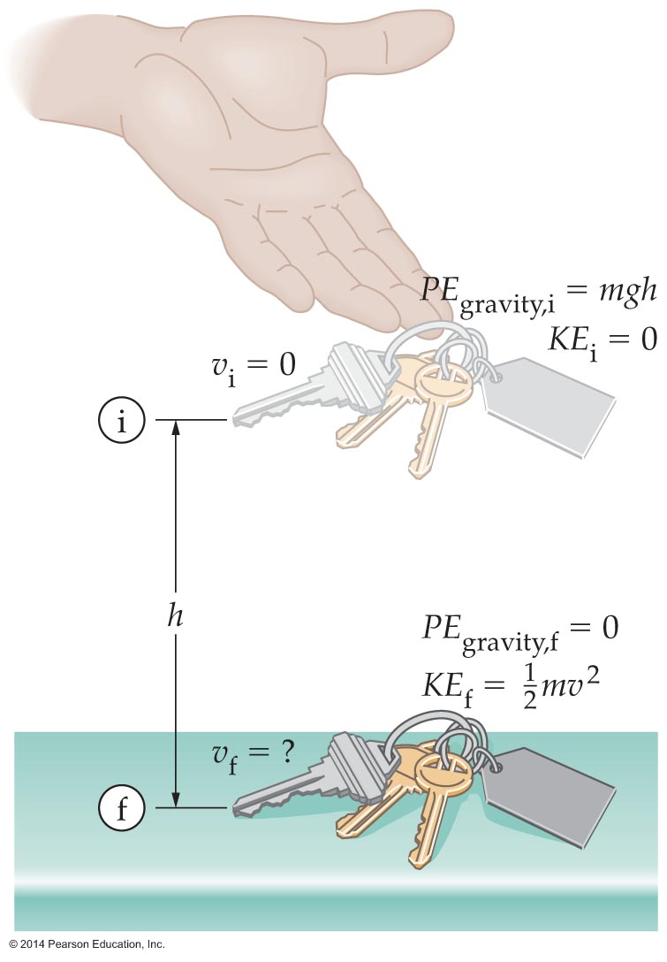
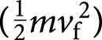
Conservation of Energy
Energy conservation may be used to solve many physics problems.
For example, energy conservation may be used to find the final speed of a set of keys dropped to the floor from a height h (see figure below).
By equating the initial potential energy at the top (mgh) to the final kinetic energy at the bottom and solving for the speed of the keys at the bottom, we find

Slide 30
Conservation of Energy
The conservation of energy means that objects moving downward through the same vertical distance but following different paths will have the same final speed.

Slide 31
Conservation of Energy
Changing the initial speed of a downward moving object by a small amount can result in a relatively large increase in final speed.

Slide 32
Power
Power is a measure of how quickly work is done. The faster work is done, the greater the power.
Formally, power is the amount of work done in a given amount of time. If work W is done in time t, then the power delivered is defined as follows:

Slide 33
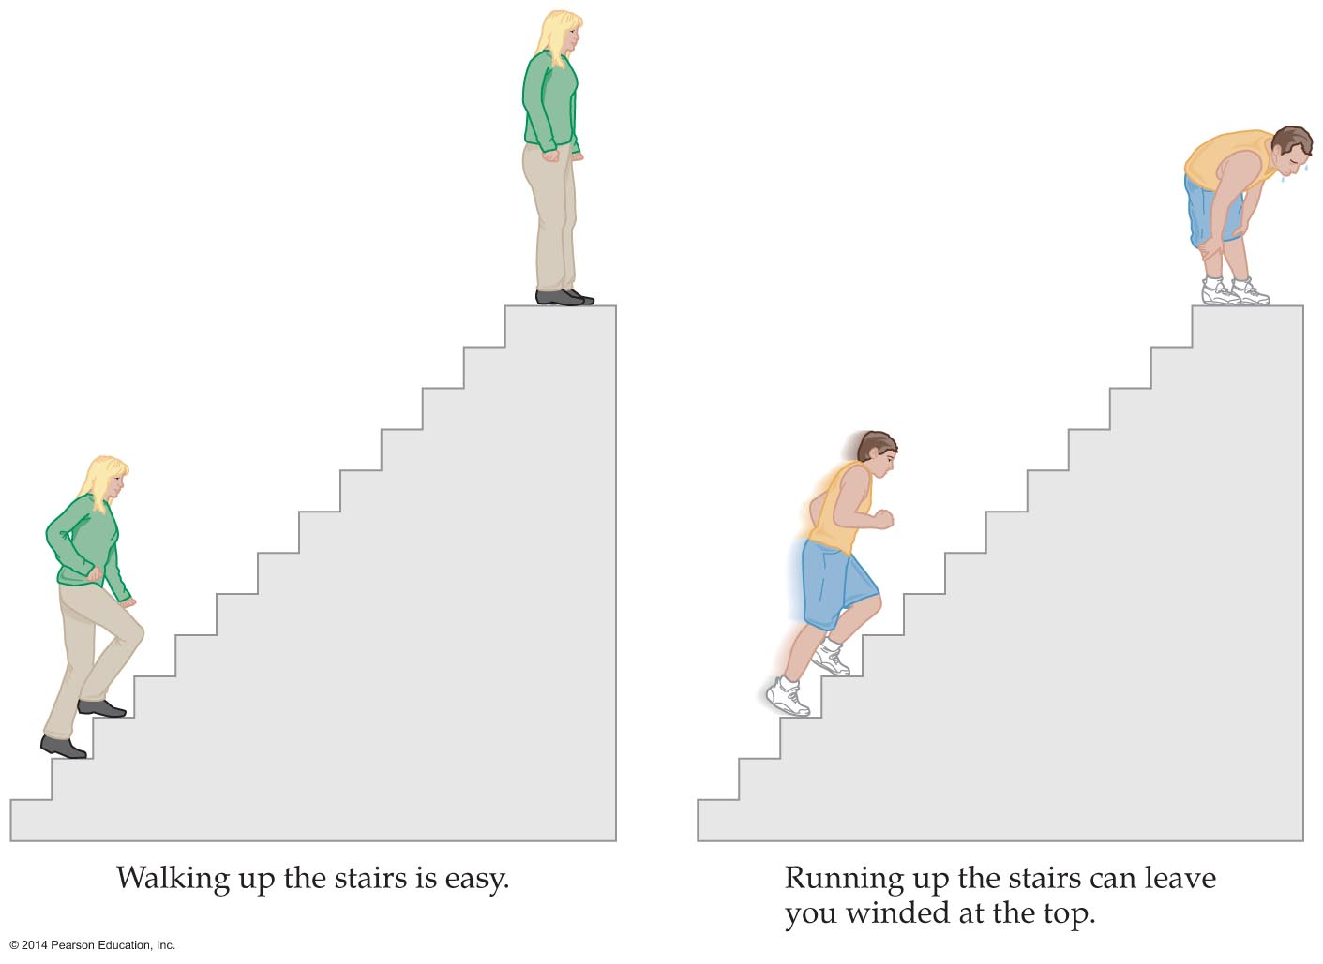
Power
To be powerful, an engine must produce a substantial amount of work in a relatively short time. Similarly, you produce more power when running up a flight of stairs than when walking up.

Slide 34
Power
The unit of power is the watt (W). The watt, named after Scottish engineer James Watt, is defined as 1 joule per second. Thus,
1 watt = 1 W = 1 J/s
A typical compact fluorescent lightbulb has a power of 23 W.
Another familiar unit of power is the horsepower (hp). The horsepower is defined as follows:
1 horsepower = 1 hp = 746 W

Slide 35
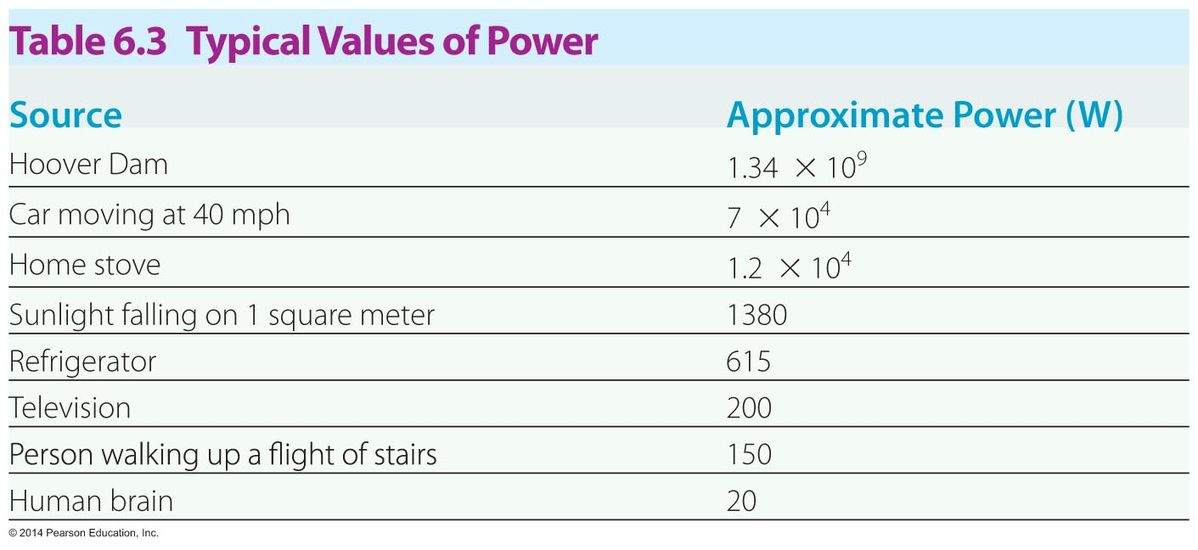
Power
Human power output is limited to about 1 hp.
A leisurely walk up a flight of stairs requires about 130 W, or 1/6 hp. A person running up the same stairs might be able to produce a little over hp.
Examples of power appear in the table below.

Slide 36
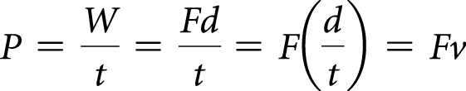
Power
Power output is an important factor in the performance of a car.
The greater the power, the less the time it takes a car to accelerate.
Power depends on force and speed. As a car travels a distance d, the work done by the engine W = Fd, and the power it delivers is
Therefore, power is equal to force times speed.

